Slide 1
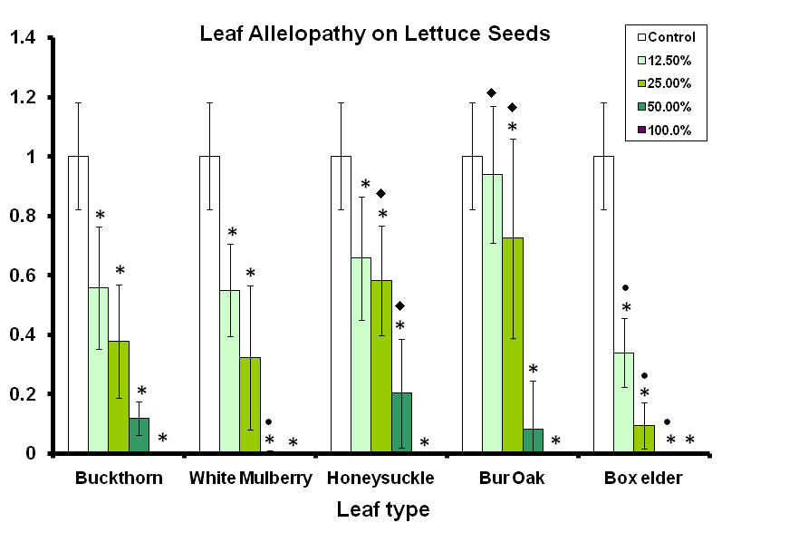
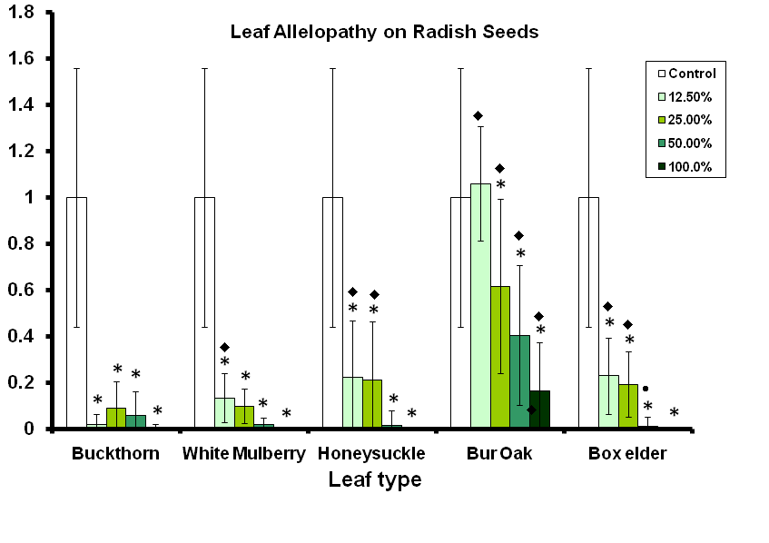
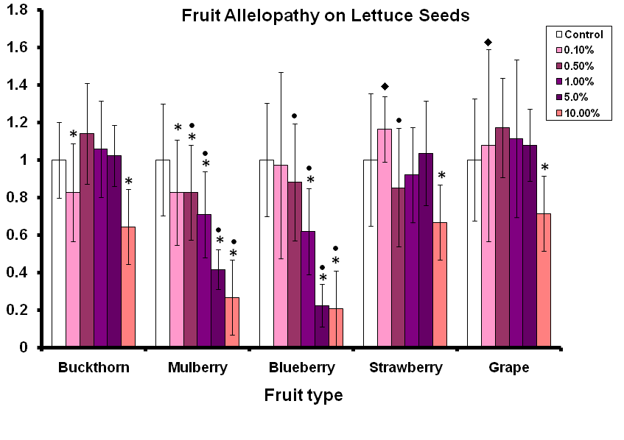
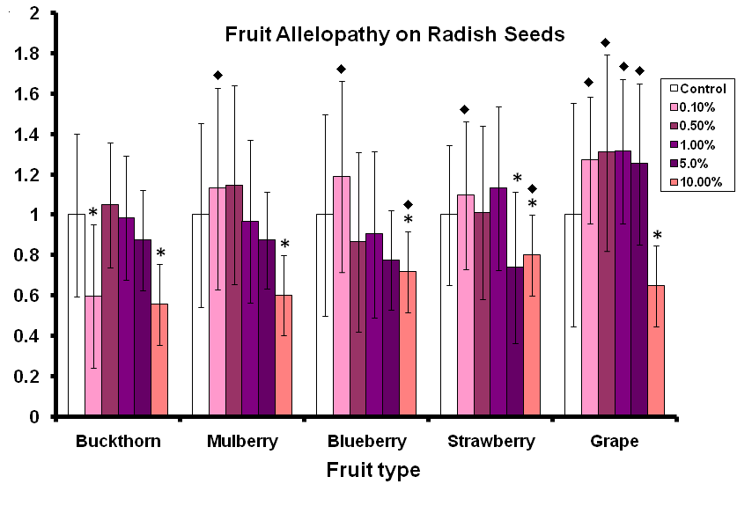
The Allelopathic Properties of Fruit and Leaf Extracts of the Invasive European Buckthorn (Rhamnus cathartica) and White Mulberry (Morus alba)
E. Boyd, T. Tracy, J. Noble, E. Brogan, J. Gaster, and H. Doty
Northwestern College, Orange City, Iowa
ABSTRACT
Allelopathy is the ability of a plant to prevent competition for resources by inhibiting the germination and/or growth of other plants via the release of secondary metabolites from its tissues. European buckthorn Rhamnus cathartica is often described as having allelopathic properties, although the primary research supporting such claims is either lacking or questionable in that buckthorn’s allelopathic properties are not compared to those of other plant species. In previous studies, we examined the germination rates and seedling lengths of radish and lettuce seeds germinated in various concentrations of buckthorn fruit extract compared to blueberry, blackberry, strawberry, and grape extracts; and various concentrations of buckthorn leaf extract compared to leaf extracts of native and other invasive trees and plants. In our current study, we modified the protocol of our earlier study by germinating seeds on a single piece of filter rather than between two pieces of filter paper, and we filtered leaf extracts rather than collecting and using the supernatant. We also included in our current study the fruit of the white mulberry Morus alba, an invasive tree that is not commonly thought to exhibit allelopathic properties but whose leaves appeared to be particularly allelopathic in our previous studies. We found that buckthorn leaf and fruit extracts were generally no more allelopathic than some of the other leaves and fruits tested and conclude that buckthorn’s allelopathic properties may be overstated in the literature.
Fig. 1. Experimental set-up for radish germination experiment.
Total length (as proportion of control)
Total length (as proportion of control)
INTRODUCTION
Allelopathy is the inhibition of one plant by another via biochemical reactions caused by the leaching, decomposition, and exudation of plant leaf, fruit, and root material. One of the most common effects is decreased germination and growth of other plants. One of the best known of the allelopathic plants is the sunflower, whose seeds exude a toxin that kills surrounding plants, which is why many sunflower-seed-containing bird feeders overhang dead spots in lawns.
European or common buckthorn Rhamnus cathartica is an invasive plant initially introduced into the U.S. in the mid-1800’s as an ornamental shrub. Among buckthorn’s many purported negative attributes are its ability to alter soil nitrogen content (Heneghan et al. 2002, Heneghan et al. 2006), outcompete native shrubs and trees for light and other resources (Fagan & Peart 2004), , and inhibit the growth of other plants via allelopathy (Vincent 2006). However, little research has been published to support the claim that buckthorn is allelopathic, and like most allelopathy studies in the literature, the plant in question is never compared to other plants not known to be allelopathic.
We hypothesized that all leaf extracts tested would be toxic at high extract concentrations thus making “allelopathy” a epiphenomenon in European buckthorn not the solely for the purpose of inhibiting the growth of other plants. If such is the case, buckthorn (or any other plant) should be labeled as allelopathic only if it is more capable of inhibiting the growth of competition than most other plants. In this experiment, we compared the inhibitory effects of buckthorn leaves and berries of various concentrations to extracts of the leaves and berries of other species to determine whether a) buckthorn and these other plants exhibit “allelopathy”, in the traditional sense of the word, and b) whether buckthorn is more allelopathic than these other leaves and fruits, thus justified the sinister “allelopathic” label.
Fig. 3b. The growth of radish seedlings in leaf extracts of various concentrations, relative to control plates. Asterisks (*) indicate significant inhibition of seedling growth compared to control. All leaf extracts significantly decreased lettuce seedling growth at all concentrations, except for bur oak at 12.5%, with higher concentrations generally showing greater inhibitory effects.
Circle (•) indicates treatments showing significantly greater growth inhibition than the buckthorn treatment of the same concentration, and diamonds (♦) indicate treatments showing significantly less growth inhibition than the parallel buckthorn treatment. Most treatments displayed considerable growth inhibition, but buckthorn treatments were generally more “allelopathic” than parallel non-buckthorn treatments.
DISCUSSION
This study examined the “allelopathic” properties of the leaves and fruit of European buckthorn by germinating lettuce and radish seeds in leaf and fruit extracts of European buckthorn and the leaves and fruits of other plant species, including the invasive white mulberry. It was hypothesized that at high concentrations, all of the plant tissue extracts would inhibit seed germination and growth, and that buckthorn would not be more allelopathic than other species. If both of these are the case, then buckthorn is not “allelopathic” to a meaningfulness enough degree for scientists too ascribe allelopathy as a mechanism responsible for the spread of buckthorn across our native landscape.
We found that all leaf extracts were allelopathic to both lettuce and radish seeds and seedlings. White mulberry and box elder showed greater allelopathy toward lettuce seeds/seedlings than buckthorn, while buckthorn was found to be generally more allelopathic toward radish seeds/seedlings than the other leaf extracts tested, although buckthorn was considerably more allelopathic than only one species: bur oak.
Only white mulberry and blueberry fruit extracts were found to be allelopathic toward lettuce seeds/seedlings in the majority of concentrations tested, and both were more allelopathic toward lettuce seeds/seedlings than buckthorn . None of the fruit tested were particularly allelopathic toward radish seeds/seedlings, but all showed significant growth inhibition at the highest concentration tested. Buckthorn appeared to be more inhibitory than strawberry and grape, although, especially in the case of the grape extract, it appears that the other extracts may in fact enhance growth, rather than buckthorn inhibiting growth, per se.
We believe that conclusions about allelopathy in highly competitive species based solely on evidence from extracts of that single species are highly suspect and that such conclusions should instead be based on evidence from comparative experiments such as those described herein. In this study, we found that the leaves of buckthorn were not particularly more allelopathic than many of the other leaves tested, especially toward lettuce seeds/seedlings. We also found that the fruit extracts were a) less allelopathic than mulberry and blueberry extracts toward lettuce seeds and seedlings, and b) not particularly allelopathic toward radish seed/seedlings at the concentrations tested.
To the extent that we can draw conclusions about buckthorn’s allelopathic properties from using lettuce and radish seeds, we conclude that buckthorn’s allelopathic properties are overrated. However, because of the important biochemical reactions occurring between specific plant species in the environment, we propose that further experiments examine the effects of buckthorn and other species’ extracts on native plants rather than commercially available lettuce and radish seeds.
Fig. 3a. The growth of lettuce seedlings in leaf extracts of various concentrations, relative to control plates. Asterisks (*) indicate significant inhibition of seedling growth compared to control. All leaf extracts significantly decreased lettuce seedling growth at all concentrations, except for bur oak at 12.5%, with higher concentrations generally showing greater inhibitory effects.
Circles (•) indicate treatments showing significantly greater growth inhibition than the buckthorn treatment of the same concentration, and diamonds (♦) indicate treatments showing significantly less growth inhibition than the parallel buckthorn treatment. Honeysuckle and bur oak showed somewhat less“allelopathy” than buckthorn at some concentrations, while white mulberry and box elder showed greater “allelopathy”, especially boxelder, which completely inhibited seedling growth at 50% concentration.
Total length (as proportion of control)
Total length (as proportion of control)
METHODS
Leaf extracts: Leaves of European buckthorn, box elder, Amur honeysuckle, bur oak, and white mulberry were collected in early to mid-October of 2008 at Northwestern’s 5-acre floodplain forest near Alton, Iowa and Oak Grove Park near Hawarden, Iowa. Leaves were gathered directly from the trees/plants in addition to recently shed leave. Leaf extracts were prepared by drying and weighing 10g of each leaf type, chopping them into small pieces, and placing the pieces in 250-ml lasks with 100 ml of distilled water. Flasks were autoclaved and placed in a shaking incubator, stirring at a rate of 150rpm for 3 days. Each solution was then vacuum filtered, and serial dilutions of 50%, 25%, and 12.5% were made, along with the full extract concentration (100%).
Fruit extracts: White mulberries were harvested in August from trees along the Puddle Jumper Trail near Orange City. Berries were washed and frozen until trials began. Buckthorn berries were collected in September directly from trees in Oak Grove Park. Enough berries were gathered to obtain approximately 50ml of juice extract. This amount of juice was also extracted from frozen blueberries, grapes, and strawberries (purchased at the grocery store) by squeezing the fruit through cheesecloth. Extracts were then autoclaved, and dilutions of 10%, 5%, 1%, 0.5%, and 0.1% of each extract were made using autoclaved, distilled water.
For the leaf extract experiment only, radish and lettuce seeds were sterilized by immersion in a 0.3% KMnO4 solution for one minute. For both radish and lettuce seed trials, plates were prepared for each leaf extract by placing six seeds onto a sheet of filter paper in a disposable 90mm Petri plate (Fig. 1). Three ml of the leaf extract were added to moisten the filter paper and seeds. For fruit-extract trials, four replicate plates were made of each of the five extract concentrations plus an autoclaved distilled-water control, for a total of 24 plates. For leaf extract trials, four replicate plates were made of each of the four extract concentrations for a total of 16 plates for each. Five control plates were prepared with an autoclaved distilled-water control. All plates for each extract type and control were sealed with Parafilm, randomly arranged on a tray, and placed in a dark cabinet to germinate.
Lettuce and radish seeds were allowed to germinate (3 and 5 days respectively), and root and shoot length of each seedling was measured (Fig. 2a&b). Seeds that did not germinate were recorded as having zero growth in both root and shoot categories.
To determine whether plant extracts inhibited seedling growth, independent-sample t-tests were performed to compare mean total seedling length between each treatment and its control (e.g., 10% buckthorn berry extract vs. buckthorn’s control). To determine whether buckthorn extracts showed evidence of greater inhibition of seedling growth than the extracts of other plants, independent-sample t-tests were performed on seedling lengths (as a % of the mean control seedling length) between each concentration of buckthorn extract and that concentration of every other extract.
Fig. 4a. The growth of lettuce seedlings in fruit extracts of various concentrations, relative to control plates. Asterisks (*) indicate significant inhibition of seedling growth compared to control.
Circles (•) indicate treatments showing significantly greater growth inhibition than the parallel buckthorn treatment, and diamonds (♦) indicate treatments showing significantly less growth inhibition than the parallel buckthorn treatment. Buckthorn fruit extracts showed more allelopathy than grape and strawberry, but only at the lowest concentration, while mulberry and blueberry extracts showed considerably more allelopathy than buckthorn at most concentrations.
Fig. 4b. The growth of radish seedlings in fruit extracts of various concentrations, relative to control plates. Asterisks (*) indicate significant inhibition of seedling growth compared to control.
Diamonds (♦) indicate treatments showing significantly less growth inhibition than the parallel buckthorn treatment. Buckthorn extracts showed more growth inhibition than all other extracts at 0.10% and more growth inhibition than blueberry, strawberry, and grape at at lest one other concentration.
RESULTS
Leaf extracts on lettuce seeds: All leaf extracts, with exception to the 12.5% bur oak dilution, significantly inhibited lettuce seedling growth compared to the control treatment at all extract concentrations, with higher concentrations showing greater inhibition than lower concentrations (Fig. 3a). Buckthorn leaf extracts showed intermediate inhibitory effects compared to the other leaf extracts tested, with Amur honeysuckle and bur oak showing somewhat less allelopathy than buckthorn at some concentrations, and white mulberry and box elder showing greater allelopathy, especially boxelder, which completely inhibited seedling growth at 50% concentration.
Leaf extracts on radish seeds: All leaf extracts, with exception to the 12.5% bur oak dilution, significantly inhibited radish seedling growth compared to the control treatment at all extract concentrations, with higher concentrations showing greater inhibition than lower concentrations (Fig. 3b). Buckthorn leaf extracts were generally more allelopathic toward radish seedlings than the other extracts tested, with only the 50% box elder extract showing more allelopathy than the parallel buckthorn extract.
Fruit extracts on lettuce seeds: All fruit extracts significantly inhibited the growth of lettuce seedlings at the highest extract concentration, but only mulberry and blueberry showed significant inhibition at other high extract concentrations. Buckthorn showed significantly greater inhibition than strawberry and grape at the lowest extract concentration, but was otherwise no more allelopathic than the other fruits tested. Both mulberry and blueberry extracts showed greater growth inhibition of lettuce seedlings at all but the lowest concentration tested.
Fruit extracts on radish seeds: All fruit extracts significantly inhibited the growth of radish seedlings at the highest extract concentration, and the only other extracts showing significant inhibition were the buckthorn 0.10% and strawberry 5% extracts.
Fig. 2a. Lettuce seedlings.
Fig. 2b. Radish seedlings.
REFERENCES
Fagan, M. and Peart, D. 2004. Impact of the invasive shrub glossy buckthorn (Rhamnus frangula L.) on juvenile recruitment by canopy trees. Forest ecology and management 194: 95-107.
Heneghan, L., Clay, C., and Brundage, C. 2002. Rapid decomposition of buckthorn litter may change soil nutrient levels. Ecological Restoration 20(2):108-111.
Heneghan, L., Fatemi, F., Umek, L., Grady, K., Fagen, K., and Workman, W. 2006. The invasive shrub European buckthorn (Rhamnus cathartica, L.) alters soil properties in Midwestern U.S. woodlands. Applied Soil Ecology 32: 142-148.
Mottl, E.C. 2007. Oak forest decline and effects of two invasive shrubs in the Midwest Driftless Area: current status and implications for the future. M.S. thesis, Iowa State University, Ames, IA.
Vincent, M. 2006. Allelopathic effects of the fruit of European buckthorn, Rhamnus cathartica. Honours thesis. Department of Biology, University of Winnipeg.

