Slide 1
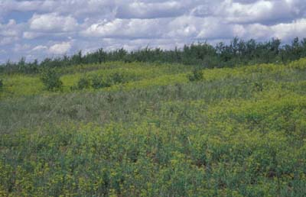
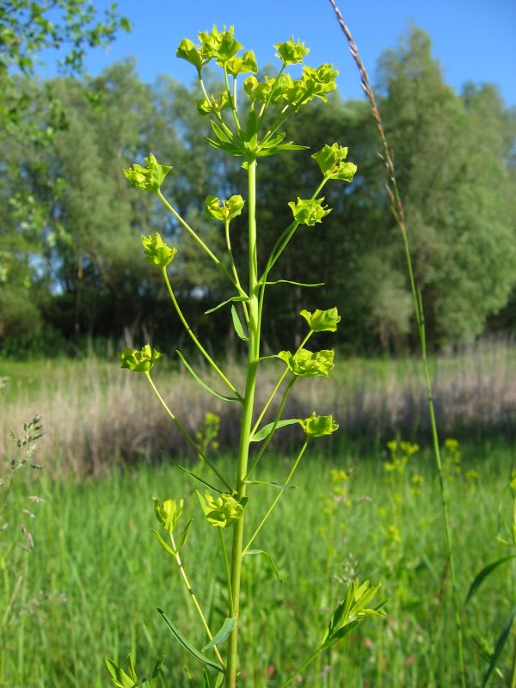
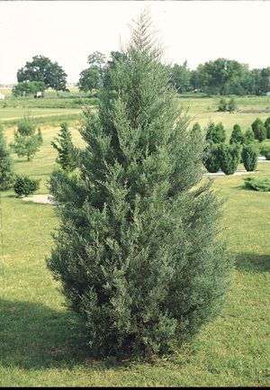
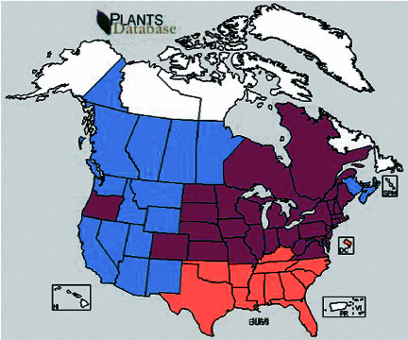
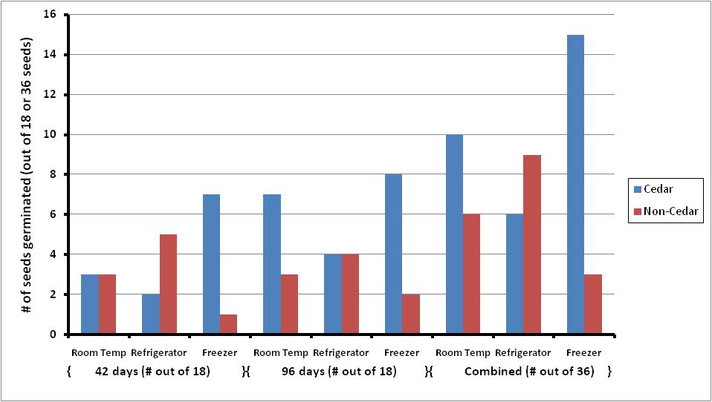
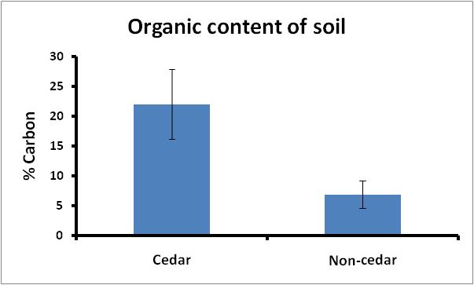
Seed dormancy in leafy spurge Euphorbia Esula and the potential for enhanced germination in the soil of eastern redcedar Juniperus virginiana H.Pagelkopf, T. McKenney, A. Wentworth, and T. Tracy
Introduction:
Leafy spurge Euphorbia esula is an invasive species that originated from Europe and temperate Asia. Habitats invaded by this species are woodlands, savannahs, and prairies. Leafy spurge prefers high sunlight areas with dry soil and can survive with little moisture due to its extensive root system, which allows spurge to outcompete native species for soil moisture. Leafy spurge is usually found in large clusters. The clusters coming from each plant produce an average of 200 seeds per year. These seeds, unless spread by animals, will only fall as far as 1-2 meters away from the mother plant (ISSG/NBII).
Little is known about the germination of leafy spurge. In part, we conducted our study to determine what temperature conditions facilitate the highest germination rates for the seeds of this noxious weed. This information was important to obtain in order to use seeds that would be more likely to germinate when we later tested germination and growth rates in cedar and noncedar soils.
Our primary motivation for this experiment was to determine whether the presence of cedar soil (i.e., soil that had been beneath the invasive eastern redcedar Juniperus virginiana) enhances the germination and growth of leafy spurge. Because the ranges of these two species overlap (Fig. 1), and because these two invasives often inhabit the same areas, knowledge of how they affect each other could potentially help us develop new ways to control their invasion.
For our temperature experiment, we predicted that the leafy spurge seeds must be frozen or chilled to have the best germination rate. For germination and growth of leafy spurge in cedar and noncedar soil, we predicted that the cedar soil would provide enhanced conditions for the germination and growth of leafy spurge.
Abstract:
Leafy spurge Euphorbia esula is an invasive forb that is rapidly spreading along roadsides and in pastures and prairies throughout the Midwest. Eastern redcedar Juniperus virginiana is another invasive creating problems in the region, and efforts have become commonplace to eradicate redcedar shrubs by cutting them at the base. The purpose of our study was twofold: 1) to learn more about seed dormancy and germination requirements of leafy spurge; and 2) to determine whether the bare soil surrounding newly cut redcedar trees contain chemicals from the redcedar that would significantly inhibit or enhance the germination and growth of leafy spurge. We found no difference in germination among leafy spurge seeds that were left at room temperature, those that were frozen for 42 and 96 days, and those that were refrigerated for 42 and 96 days. We found significantly higher germination rates for leafy spurge in cedar soil than in soil collected in nearby non-cedar areas; however, we found no difference in seedling growth rates between cedar and non-cedar treatments. A similar study performed on poppy and black-eyed Susan seeds showed no differences in germination rates or growth between cedar and noncedar soils. We posit that the removal of redcedars may create optimal colonization conditions for leafy spurge and that steps such as planting native grasses and forbs should be taken when removing redcedars in areas that have been invaded by leafy spurge.
Fig. 1 Range of Leafy Spurge (Euphorbia esula) and Eastern Red Cedar (Juniperus virginiana)
Blue = range of leafy spurge only
Salmon = range of red cedar only
Purple = range of overlap where both leafy spurge and red cedar are found
Results:
Although we had low germination rates, we conducted a chi-square analysis on the proportion of germinated seeds that were refrigerated and frozen for 42 days and 96 days for both the cedar and non-cedar soil (Fig. 2). We found no difference in germination in cedar soil for seeds that were either refrigerated or frozen for 42 days (chi-square=3.704) or for 96 days (chi-square=0.468; chi-square crit.=3.84). We found no difference in germination in non-cedar soil for seeds that were either refrigerated or frozen for 42 days (chi-square=3.2) or for 96 days (chi-square=0.8; crit.=3.84).
We then combined the data into seeds that were kept at room temperature, put into the refrigerator, or into the freezer and compared them based on the soil type they were grown in (cedar vs. non-cedar soil; Fig. 2). Seeds grown in cedar soil germinated significantly more than seeds grown in non-cedar soil (chi-sq=4.461, crit.=3.84).
While growing the seeds we measured the growth of the leafy spurge, we found no difference in seedling growth after germination. Seeds refrigerated for 42 vs. 96 days showed no significant growth difference (t=3.182, p=0.304) in cedar soil, and seeds that were frozen for 42 vs. 96 days showed no significant growth difference (t=2.179, p=0.213) in cedar soil either. Also, the seeds grown in non-cedar soil showed no significant difference in germination when they were refrigerated (t=2.571, p=0.869). No p value could be calculated for the seeds that were frozen for 42 days vs. 96 days because only one seed that was frozen for 42 days germinated in the non-cedar soil.
Since we had low germination rates, we combined the data and ran a t-test on the growth of the seeds grown in cedar vs. non-cedar soil. The test showed no significance (t=2.030, p=0.206) on the effects of seed growth in cedar vs. non-cedar soil.
We also compared the amount of organic material and moisture in the cedar vs. non-cedar soil. We found that the cedar soil had significantly more organic material than the non-cedar soil (t=2.45; p=0.0003; Fig. 3), and that the cedar soil also had a significantly higher moisture content (30.3% vs. 19.2%; p=0.004).
Materials and Methods:
Our research was conducted in fall 2009 on the campus of Northwestern College (Orange City, IA) in Van Peursem Hall, Room 221. First, we obtained leafy spurge seeds from Oak Grove County Park (Sioux County) on July 20, 2009. After collecting the seeds, we placed them at different temperatures for varying amounts of time as a precursor for later determining the conditions that would produce the highest germination rates. We placed ~200 seeds in each of several unsealed Ziploc baggies. We placed several bags at room temperature (20 – 25 °C). We placed others in a freezer (approximately -18ºC) from August 2nd to November 6th (96 days total) and from September 25th to November 6th (42 days total). We placed the remaining groups in a refrigerator (~2°C) from August 2nd to November 6th (96 days total) and from September 25th to November 6th (42 days total).
To test the effect of eastern red-cedar on the germination of leafy spurge seeds, we collected cedar and non-cedar soil from Oak Grove on November 4, 2009. The soil was found beneath two cedar trees approximately 10 meters away from open grassland where downy brome was dominant. The non-cedar soil was obtained from this grassy area. Leafy spurge was seen on-site, but not in the vicinity of where the soil was collected. We created six 10x20 cm trays of cedar soil and six of non-cedar soil. Each tray was filled with soil to a depth of approximately 5 cm. In three of the cedar trays, we created three rows (room temperature=RT, frozen for 42 days=FZ 42), and refrigerated for 42 days =FG 42) of 6 seeds each. In the other three cedar trays, we created 3 rows (RT, FZ 96 days, and FG 96 days) of 6 seeds each. Likewise, we created 3 non-cedar trays with RT seeds and seeds from 42 days and 3 with RT seeds and seeds from 96 days. For each set of three trays, the rows were arranged as follows: RT – FZ – FG; FG – RT – FZ; FZ – FG – RT. After watering and covering the trays with cellophane, we placed them all under a growth light with a 12L:12D timer for 14 days. Every day the trays were rotated to ensure uniform lighting for all seeds. After 4 days, the cellophane was removed. For each of the next 10 days, we poured 20 ml of water in each tray. At the end of 14 days, we noted the germination in each of the trays and measured growth (cm) of those seeds that did germinate. We conducted a chi-square analysis to determine if the proportion of seeds that germinated differed between cedar vs. non-cedar soil.
To determine the organic content of the cedar versus non-cedar soil, we weighed six samples (14 – 19g) of each soil type and placed them in individual aluminum foil boats. We also weighed six empty aluminum boats as controls to ensure that the weight of the boats would not change significantly after drying and heating. After drying the samples at 70 ºC for 4 days, we weighed them again to determine the moisture content of cedar vs. non-cedar soil. Next, we heated the samples and the control boats at 500 ºC for 20 hours to burn away all organic material. We weighed the boats one final time in order to determine the organic content of each soil type. We conducted independent-sample t-tests to see if the organic content and moisture content of the cedar soil were significantly different from the non-cedar soil.
Fig. 2 After planting the seeds from 42 and 96 day treatments in cedar and non-cedar soils, we found that in both soil types, the proportion of seeds that germinated after 42 days was not significantly different from those that germinated after 96 days. Therefore, the germination data from both 42 and 96 days were combined. We found that seeds were more likely to germinate in cedar soils (31/108) than non-cedar (18/108; Chi-square = 4.46; Chi-square critical = 3.84), but found no significant difference in the temperature treatment of leafy spurge seeds on the success of their germination.
Discussion:
After conducting this experiment, we found that leafy spurge seeds do not need to be refrigerated or frozen for a length of time before they germinate. We found no significant difference in the amount of time seeds were either refrigerated or frozen. Leafy spurge seeds thus, do not need to overwinter in order to germinate. We did find that leafy spurge seeds germinate better in cedar soil vs. non-cedar soil. We also found that cedar soil contains more organic material than non-cedar soil.
Since more leafy spurge in the cedar soil than the non-cedar soil, this result can provide us with some insight as to a possible allopathic and inhibitor relationship between cedars and leafy spurge. In fact, cedar soil has been known to contain a chemical which suppresses the growth of other plants around it (Stowe 1979). However, leafy spurge seems to be able to grow in the allopathic soil anyway. Nonetheless, if cedar trees are removed from an area, its absence could create an environment for leafy spurge to invade and cause other problems. The restoration of natural prairies and the disturbance of habitat by removal of the eastern red cedar could cause a different invasive species to succeed the cedars (Sheley, Mangold, and Anderson, 2006). The cedar soil contains more organic matter, which would allow it to retain more moisture and possibly enhance seed germination. A similar study performed at Northwestern College in spring 2009 on poppy and black-eyed Susan seeds showed no differences in germination rates or growth between cedar and non-cedar soils, suggesting that leafy spurge may differentially benefit from redcedar removal. We posit that the removal of redcedars may create optimal colonization conditions for leafy spurge and that steps such as planting native grasses and forbs should be taken when removing redcedars in areas that have been invaded by leafy spurge. So, removing one invasive species could create a prime habitat for another invasive species to take over.
Fig. 3 After drying both soil types and burning away all organic material, we found that the cedar soil had significantly more organic material in it than the non-cedar soil (p<0.001). Bars represent standard deviation.
References:
"Euphorbia Esula (herb)." Global Invasive Species Database. National Biological Information Infrastructure (NBII) and Invasive Species Specialist Group (ISSG), 26 June 2005. Web. 13 Dec. 2009.
Sheley, R. L., Mangold, J. M., Anderson, J. L. (2006). Potential for Successional Theory to Guide Restoration of Invasive-Plant-Dominated Rangeland. Ecology, Vol. 76, No. 3, 365-379. Retrieved February 12, 2009, from JSTOR.
Stowe, Lawrence G. (1979). Allelopathy and its influence on the Distribution of Plants in an Illinois Old-Field. Ecology, Vol. 67, No. 3, 1065-1085. Retrieved February 12, 2009, from JSTOR.

