Slide 1
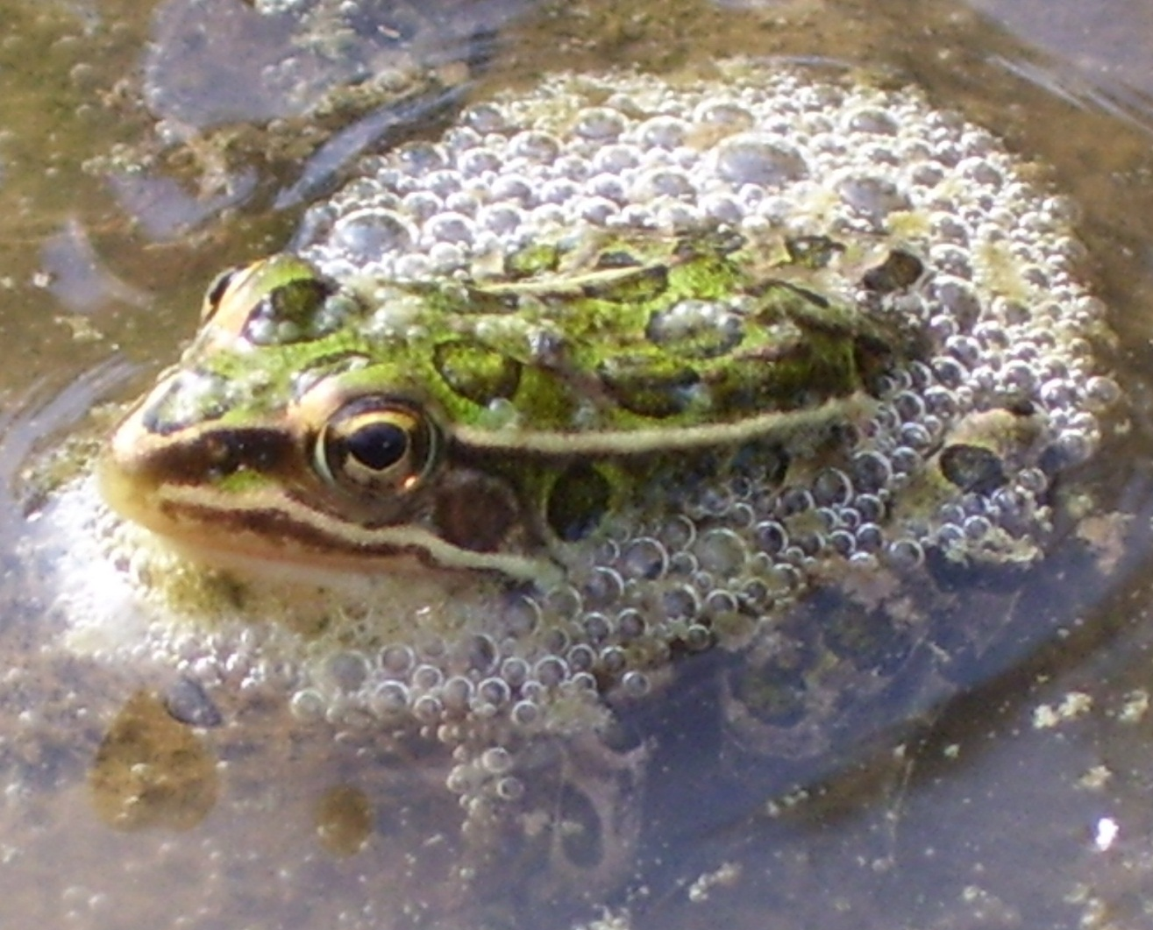
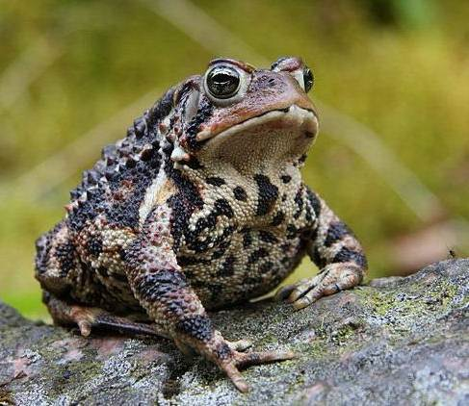
DOES EUROPEAN BUCKTHORN AFFECT THE DISTRIBUTION OF ANURANS IN A GALLERY FOREST? T. Tracy and O. Norman Northwestern College, Orange City, IA
Abstract
This study explores the effects of the invasive shrub European buckthorn Rhamnus cathartica on amphibian abundance and distribution in Northwestern College's riparian forest near Alton, Iowa. While pitfall trapping for invertebrates in treatment plots (where buckthorn shrubs and trees had been removed) and control plots (left alone), we unintentionally caught 131 American toads Bufo americanus and 7 northern leopard frogs Rana pipiens. We found no significant difference in the number of amphibians trapped between treatment and control plots, nor did we find a significant relationship between buckthorn density and amphibian density in control plots. Although buckthorn appears to have negatively affected populations of amphibians such as spotted salamanders and wood frogs in other regions, we found no evidence that buckthorn negatively impacts habitat use by American Toads and Northern Leopard Frogs in our forest.
Introduction
European buckthorn (Rhamnus cathartica) and glossy buckthorn (R. frangula) are invasive plant species initially imported to the U.S. in 1849 as ornamental shrubs. Researchers throughout the Eastern U.S. have found various negative ecological effects of buckthorn (e.g., increased nest predation in songbirds, Schmidt & Whelan 1999; increased soil nitrogen content, Heneghan et al. 2006; decreased herbaceous groundcover, Boudreau & Wilson 1992; decreased juvenile recruitment by canopy trees, Fagan & Peart 2004; host for [oat] crown rust and overwintering soybean aphids, Heipel et al. 2010). Since the effects found in one area of the U.S. or in one habitat may not be the same as those found in others, studies that specifically examine the local impacts of buckthorn are warranted, particularly if much effort and expense is being invested in removing and controlling the shrub.
RESEARCH OBJECTIVES:
To elucidate the short- and long-term effects of the invasive European buckthorn on Northwestern College’s 5-acre gallery forest along the Floyd River near Alton, Iowa. Ongoing monitoring includes soil analyses and surveys of vegetation and forest floor macroinvertebrates. This poster reports findings from an analysis of amphibian “by-catch” from a macroinvertebrate survey.
To determine whether expensive and time-consuming buckthorn eradication efforts are worthwhile. If long-term negative ecological effects of buckthorn are minor, then these efforts would be largely unnecessary. In addition, we need information regarding potential negative impacts of buckthorn eradication measures on native species.
Materials and Methods
In 2005, we initiated a buckthorn removal experiment in Northwestern’s forest. We established 30 20-m² plots and surveyed all trees and saplings greater than 1.5m tall in all plots, but included all buckthorn greater than 0.5m tall. We paired plots with respect to buckthorn densities (varying from 1 to 235 per plot) and tree & sapling composition using Peterson’s Homogeneity Index. For each pair, all buckthorn were removed from one plot, while the other plot was designated as the control (see color-coded pairs in Fig. 1). Control plots were resurveyed in 2007, and buckthorn reinvading treatment plots have been removed as needed.
To survey forest floor macroinvertebrates, we performed pitfall samples semi-monthly from April-October of 2006 to 2011. The trapping grid consisted of 4 pitfall traps 2 m apart near the center of each of the 30 plots. Traps consisted of plastic cups buried in the ground with their lips at ground level (see photo in upper right). We filled each cup with 2-3 cm of “death juice” (70% ethanol and liquid soap). After leaving cups in place for 24 hours, we collected and preserved the cup contents (including anurans) for later analysis. This pitfalling technique typically results in occasional “by-catch”, generally consisting of no more than a few shrews or anurans per round. However, our round of pitfall trapping July 15, 2011, resulted in the by-catch of 131 American toads Bufo americanus and 7 northern leopard frogs Rana pipiens.
To determine whether the invasive buckthorn affects habitat use by anurans, we examined the distributions of frogs and toads trapped in this trapping event, and we performed a paired t-test to compare the numbers of toads in treatment vs. control plots. We also performed a correlation/regression analysis on toad numbers in control plots to determine whether a relationship exists between toad and buckthorn densities. We hypothesized that buckthorn negatively impacts our native anurans and predicted that a) treatment plots (buckthorn removed) would show greater anuran density than control plots, and b) an inverse relationship would exist between buckthorn density and anuran density in control plots.
A
B
Figure 2. A) No significant difference was found between mean numbers of toads trapped in treatment vs. control plots. Error bars indicate standard deviations. B) No relationship was found between buckthorn and toad density in control plots.
Discussion
Invasive species have become an increasingly problematic presence in Iowa, and the full effects of these invaders are poorly understood, especially with regard to their impacts on Iowa’s native flora and fauna. In an effort to explore these effects and test our hypothesis that the invasive European buckthorn negatively impacts local plants and animals, we commenced a buckthorn-removal experiment in Northwestern College’s gallery forest in 2005 and have since been monitoring the distributions and densities of forest floor macroinvertebrates.
After inadvertently trapping a large number of anurans during a round of pitfall-trapping in 2011, we tested our hypothesis and determined that there is no evidence that anurans in our forest are negatively impacted by buckthorn. This conclusion is based on the observation that mature American toads (and to some extent, northern leopard frogs) appear to be a) evenly distributed between treatment and control plots, and b) found at similar densities in both high and low concentrations of buckthorn. It is possible, however, that buckthorn has had a larger-scale impact on amphibian populations and has caused a general decrease in amphibian numbers that would not be reflected in our distribution data. For example, Sacerdote (2009) found that pond-breeding amphibians such as the wood frog R. sylvatica and spotted salamander Ambystoma maculatum may be negatively affected by the alteration of dissolved oxygen levels in waters where buckthorn has invaded. Similarly, Brown et al. (2006) found that the invasive purple loosestrife Lythrum salicaria negatively impacted the survival rate of American toad tadpoles. Such effects would directly impact only tadpoles but would result in a general population decline that would not be revealed in a study like ours that examines the distribution of adults.
We tentatively conclude that European buckthorn does not impact habitat use by mature American toads and northern leopard frogs. However, before general conclusions can be drawn regarding the innocuousness of the invasive shrub on our local anurans, an examination of the impacts of these species on the development of tadpoles in the marsh along the east edge of our forest is warranted.
Roadside Park Pond
Floyd River
Research area
Marsh
Oxbow lake
North
2 frogs
Floyd River
Results
Northern leopard frogs
The number of frogs trapped precludes rigorous statistical analysis. However, a visual inspection of the distribution of frog captures (Fig. 1) reveals a pattern suggesting that leopard frog distribution is more closely affected by access to surface water than it is by buckthorn. All 7 frogs were trapped in plots adjacent to either Floyd River or the marsh lying just east of our forest.
American toads
We found a) no different in habitat use by toads between treatment (buckthorn removed; mean=3.9) and control plots (mean=4.8; Fig. 2A), and b) no relationship between toad density and buckthorn density in control plots, suggesting that buckthorn does not affect habitat use by American toads (Fig. 2B). (Note: log # of buckthorn was used to normalize the data for analysis.)
7 toads
2 frogs
1 frog
1 frog
6 toads
1 toad
6 toads
4 toads
4 toads
Marsh
7 toads
3 toads
8 toads
2 toads
7 toads
4 toads
1 frog
5 toads
6 toads
10 toads
8 toads
4 toads
4 toads
5 toads
References
Boudreau, D & Wilson, G. 1992. Buckthorn research and control at Pipestone National Monument. Restoration & Management Notes 10: 94-95.
Brown, C., Blossey, B. Maerz, J., & Joule, S. 2006. Invasive Plant and Experimental Venue Affect Tadpole Performance. Biological Invasions 8:327-338.
Fagan, M. & Peart, D. 2004. Impact of the invasive shrub glossy buckthorn (Rhamnus frangula) on juvenile recruitment by canopy trees. Forest Ecology and Management 194:95-107.
Heimpel, G., Frelich, L., Landis, D., Hopper, K., Hoelmer, K., Sezen, Z., Asplen, M., & Wu , K. 2010. European buckthorn and Asian soybean aphid as components of an extensive invasional meltdown in North America. Biological Invasions 12:2913-2931.
Heneghan, L., Fatemi, F., Umek, L., Grady, K., Fagen, K., and Workman, W. 2006. The invasive shrub European buckthorn (Rhamnus cathartica, L.) alters soil properties in Midwestern U.S. woodlands. Applied Soil Ecology 32: 142-148.
Schmidt, K. & Whelan, C. 1999. Effects of exotic Lonicera and Rhamnus on songbird nest predation. Conservation Biology 13:1502-1506.
Sacerdote, A. 2009. Reintroduction of extirpated flatwoods amphibians into restored forested wetlands of northern Illinois: Feasibility assessment, implementation, habitat restoration, and conservation implications. Northern Illinois University, ProQuest, UMI Dissertations Publishing. 3390589.
2 toads
8 toads
3 toads
2 toads
5 toads
North
2 toads
1 toad
2 toads
5 toads
Fig. 1. Aerial view of Northwestern College’s forest, with inset showing research and control plots, with pre-removal numbers of buckthorn trees and saplings indicated. Paired plots are indicated with the same color fill. Treatment plots (buckthorn removed) are indicated with a slash. Numbers of northern leopard frogs and American toads trapped in July 2011 are shown.

