Slide 1
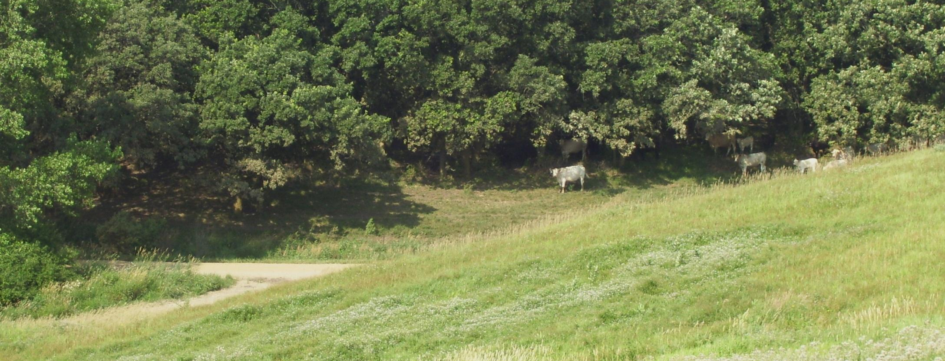
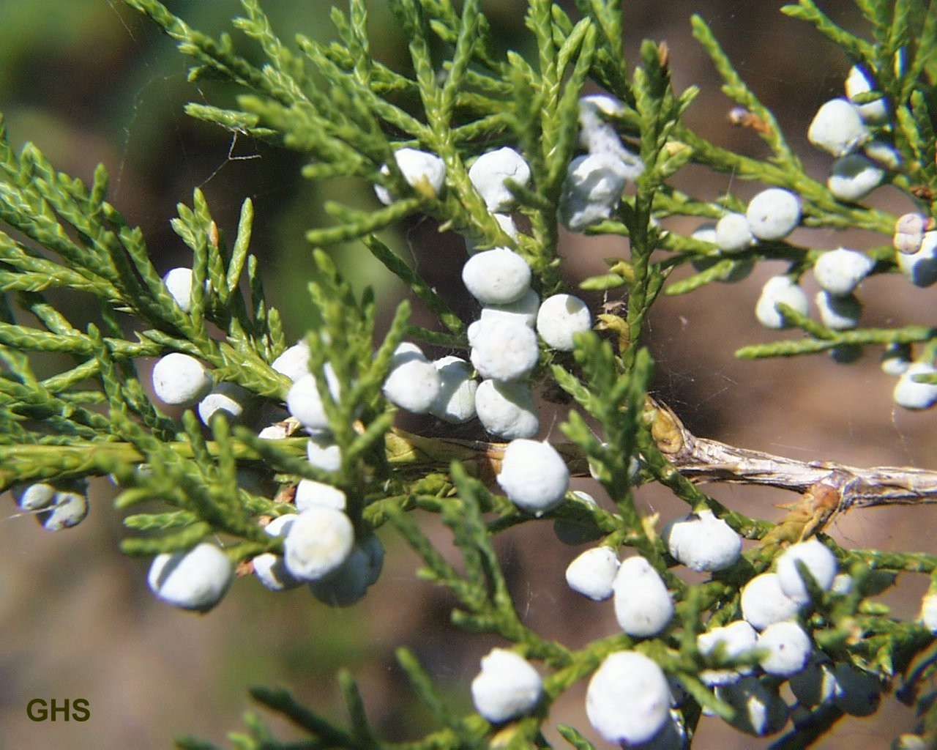
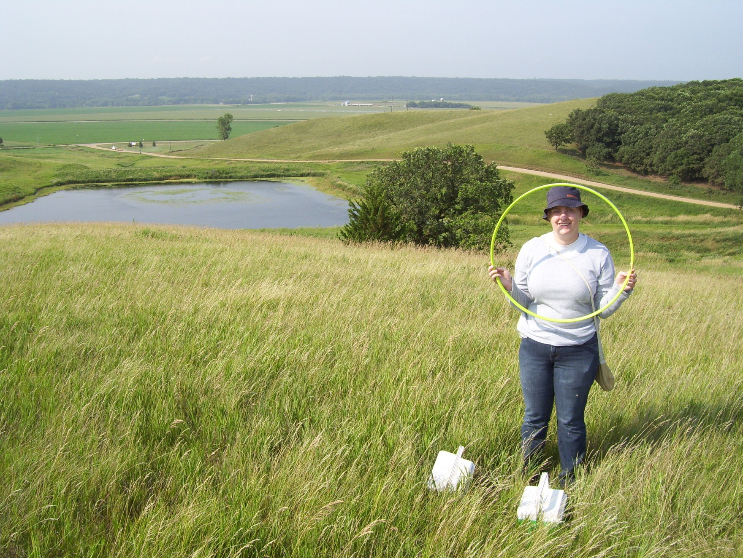
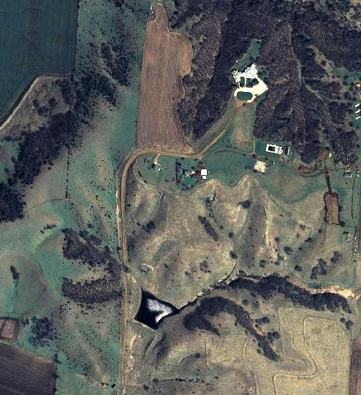
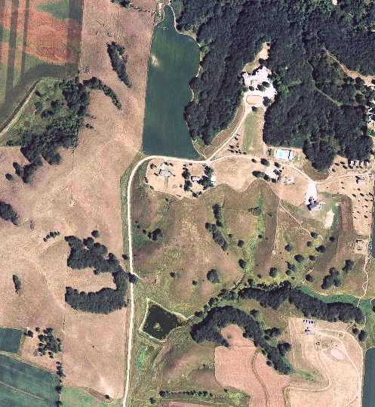
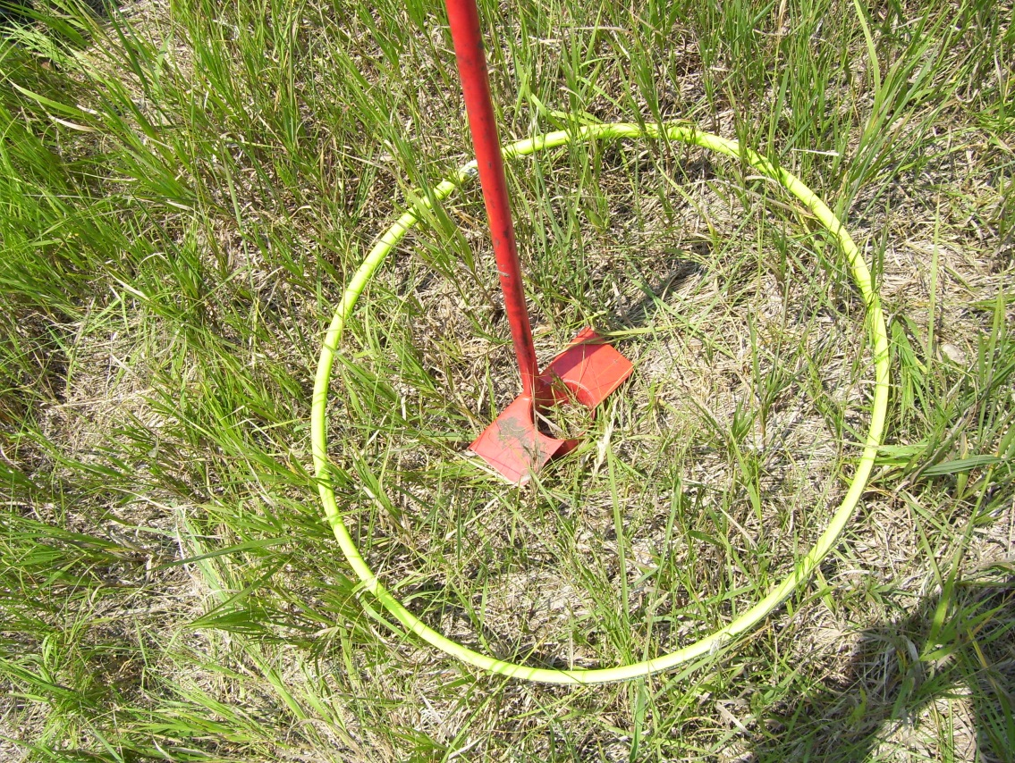
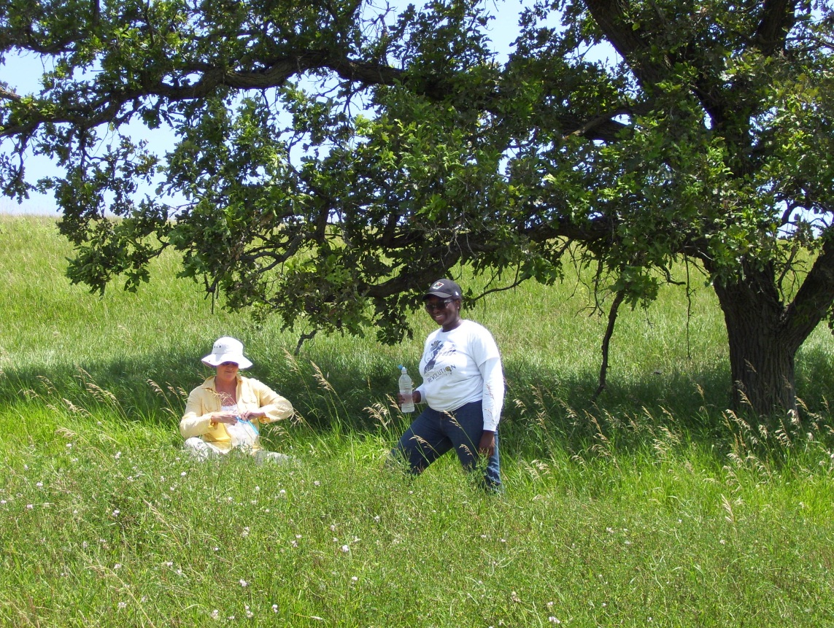
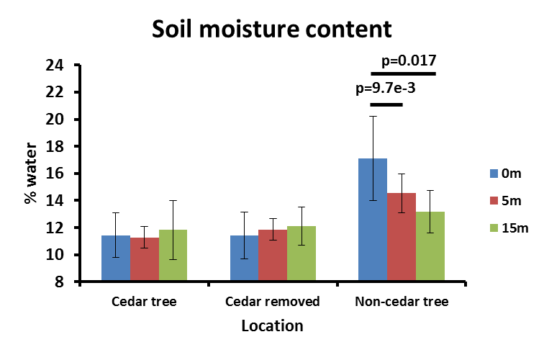
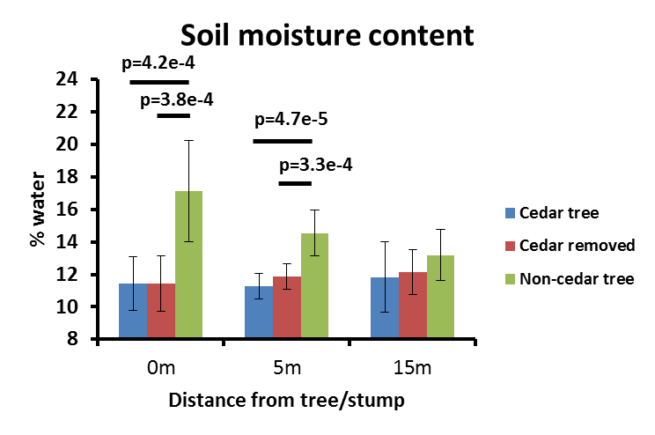
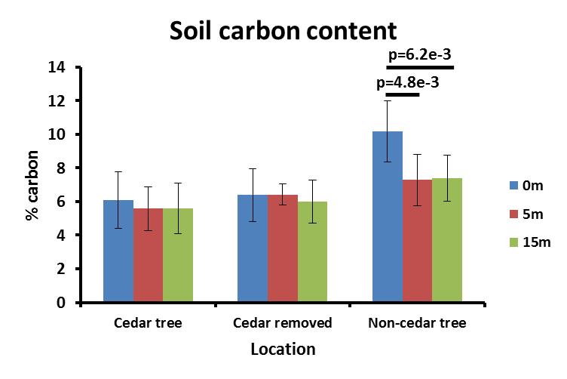
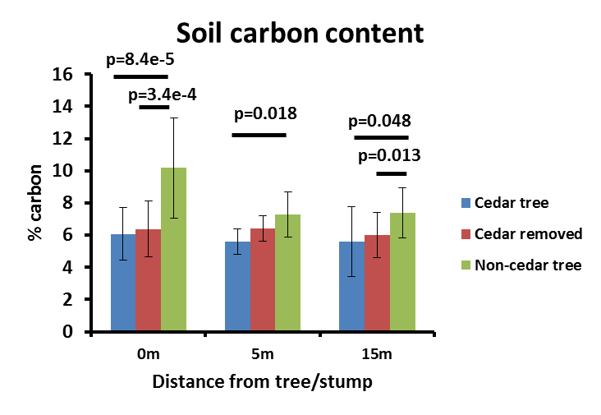
THE EFFECT OF EASTERN RED CEDAR ON SOIL PROPERTIES IN A NORTHWEST IOWA PRAIRIE O. Norman and T. Tracy Northwestern College, Orange City, IA
Abstract
Eastern red cedar is a conifer native to the eastern U.S. that has become an insidious invader of prairie communities in the Midwest, including prairie pastures at Inspiration Hills Camp and Retreat Center in northwestern Sioux County, Iowa, where most of the red cedars were removed from the pastureland during summer 2010. To assess the effect of red cedars on the moisture and carbon content of soil at Inspiration Hills, we collected soil samples at 0m, 5m, and 15m from red cedar trees, red cedar stumps, and non-cedar control trees during summer 2011. We found that soil beneath non-cedar trees was higher in moisture content than soil 5m and 15m away, while the pattern was non-existent for red cedar trees and red cedar stumps. Furthermore, soil beneath non-cedars (0m) and 5m from non-cedars was higher in moisture content than soil beneath and near red cedar trees and stumps. We also found that soil beneath non-cedars was higher in organic content than was soil 5m and 15m away, while the pattern was non-existent for red cedar trees and stumps. Likewise, soil beneath and near non-cedars (0m, 5m, and 15m) was higher in organic content than soil beneath and near red cedar trees and stumps. Although we did not find decreased carbon and moisture content in soil beneath red cedars compared to the surrounding soil, we found that red cedars did not have the positive effect on soil moisture and carbon content that non-cedar trees exhibit.
Introduction
Eastern red cedar Juniperus virginiana is a North American shrub/tree that been invading prairies and pastureland across the central U.S. The species is able to spread quickly because it can grow under various climatic and soil conditions and because it produced copious seeds that are distributed across the landscape by birds (Holthuijezen et al. 1987). Red cedar is useful for windbreaks and building material; however, habitat degradation, plus the resulting economic losses from lost pastureland/rangeland and lost hunting leases, decreased stream water quality, increased risk of catastrophic wildfire, and lowered water tables appear to outweigh the benefits of the species in many areas (Drake & Todd 2002).
Inspiration Hills (IH) Camp and Retreat Center lies in hilly terrain just west of the Big Sioux River floodplain, along the Iowa-South Dakota border. Much of the land at the retreat center is historic prairie used for cattle grazing and for hiking, horseback riding, and other recreational activities. Fire suppression and the intentional planting of red cedar on nearby properties led gradually to the invasion of red cedar into IH property. Because of declining aesthetics (red cedars are generally considered unattractive) and loss of grazing income, the folks at IH removed most of the red cedars in 2010 (leaving the stumps), but ~14 male red cedars were left standing for research purposes. We are using these males to examine the effects of eastern red cedars on macroinvertebrates, vegetation, and soil properties. This poster reports our initial findings on soil properties, specifically moisture content and carbon content. We hypothesized that red cedar would negatively affect prairie soil and predicted that that soil beneath and near red cedar trees would be lower in both moisture and carbon content than soil beneath and near non-cedar trees.
Discussion
These results support our hypothesis that red cedar trees have a negative effect on soil properties in pastureland and prairie remnants, and that these effects are not simply the generic effects that all woody species have on such ecosystems. The lack of soil moisture beneath red cedars compared to non-cedars could be due to the red cedars’ increased use of water or the red cedar canopy’s increased ability to divert the rain around their bases (Pierce). The other woody species in our study were considerably taller and would not have diverted rainwater to such an extent. While we found no difference in moisture content beneath red cedars vs. out in the open (at 5 and 15m), Pierce et al. found higher water content under cedar trees than in the open grasslands. However, Pierce et al. only compared red cedars to open grasslands, so it remains unclear in their study how red cedars affect the prairie ecosystem relative to “benign” species.
Non-cedar soil showed greater carbon content at all distances than cedar soils. This could be explained by the fact that our non-cedars (oak and ash) are deciduous and provide an annual influx of organic material to the soil, while cedars are evergreen, retaining their needles for several growing seasons. Furthermore, cedars prevent the growth of prairie plants beneath their canopy, while oaks and ash trees do not do so, and one would expect an area with a diverse assemblage of prairie plants to have a greater organic component in its soil. The reason for the similarity in carbon content between the cedar trees and where the cedars were removed might be because the cedars had been removed only a year prior to our study, and the soil around the removed trees is still affected (and in many cases, not yet colonized by prairie species). The soil moisture might be the same as beneath cedars because a) there is no organic material around the stumps to retain the moisture that it gains, and b) there is little vegetative cover preventing the direct evaporation of water from exposed soil. Non-cedars, on the other hand, not only allow prairie plants to grow beneath their canopy, but they also provide greater shade over a wider area to slow soil water loss via evaporation.
The economic impacts of the eastern red cedar invasion are readily apparent (e.g., lost pastureland, costs of control and eradication efforts, catastrophic losses from wildfires such as those in north-central Nebraska in 2012), while many of the ecological impacts remain obscure and poorly understood. Thus, more research such as ours is needed to fully elucidate the scope of the ecological impact of eastern red cedar on pastureland and grasslands in the central U.S.
2007
2011
Fig. 1. Inspiration Hills before and after red cedar removal. Dark specks in 2007 image are red cedars. Oval indicates research area.
Results
We found that soil beneath non-cedar trees is significantly higher in moisture and organic content than soil 5m and 15m away, while the pattern is non-existent for cedar trees and cedar stumps (Fig. 2A & 3A). We also found that soil beneath and near non-cedars is higher in moisture and organic content than soil beneath and near cedar trees and cedar stumps (Fig. 2B & 3B).
A
B
Materials and Methods
Soil collection
On July 28, 2011, we used a soil auger to collect soil samples from beneath and near 11 red cedar trees, 9 non-cedar trees (green ash and bur oak), and 8 red cedar stumps where cedars had been removed in 2010 (Fig. 1). Samples were collected at 0m (i.e., directly beneath), 5m and 15m from trees and stumps. The soil auger provided us with a cylindrical soil sample 5 inches deep and 2.5 inches in diameter. Each cylinder was then cut at the 2in. and 3in mark, making a 1in. disk, which was placed in a labeled Ziploc freezer baggie. The rest was used to fill in the hole the next day, after the hole was used for pitfall-trapping macroinvertebrates.
Soil analyses
Using a mortar and pestle, we ground the soil samples to a uniform size and removed all rocks and roots. We measured ~5 grams of soil from each sample and placed the soil samples into weighed, labeled aluminum boats. Samples were then placed in a drying oven at 85 degrees C for two days. The soil samples were allowed to cool overnight and were then reweighed, with the difference in weight representing the amount of moisture in the soil. To burn off the organic soil components, samples were then baked in a muffle furnace at 425 degrees C for 4 hours and then allowed to cool overnight. Samples were weighed a final time to determine the amount of carbon removed. Leftover soil was stored in baggies at -80 degrees C for analysis of nitrogen and phosphorus at a later date. However, those tests were inconclusive because of problems with our spectrophotometer bulb, so we report only the results for moisture and carbon content in this poster.
We ran T-test to compare moisture and carbon content at different distances from trees/stumps (e.g., 0m vs. 5m vs. 15m away from cedar stumps) and between tree/stump types at the same distance (e.g., 0m from cedar tree vs. 0m from cedar stump vs. 0m from non-cedar tree.
Fig. 2. A) Results show that soil beneath (0m) non-cedar trees is significantly higher in moisture content than soil 5m and 15m away. No differences in soil moisture were found for the cedar and cedar-stump soils. B) Soils beneath (0m) and near (5m) non-cedar trees are higher in moisture content than soils beneath and near cedar trees and stumps. Bars connect significantly different means, with p-values for the associated t-tests shown. Error bars indicated +/-SD.
A
B
References
Buehring, N., Santelmann, P., & Elwell, H. 1971. Responses of Eastern Red Cedar to Control Procedures. Journal of Range Management 24:378-382.
Drake, B., and Todd, P. 2002. A strategy for control and utilization of invasive juniper species in Oklahoma: Final report of the redcedar taskforce. Oklahoma Department of Agriculture, Food, and Forestry.
Engle, D. M., Stritzke, J., & Claypool, P. 1980. Herbage Standing Crop around Eastern Redcedar Trees. Journal of Range Management 40:237-239.
Holthuijezen, A., Sharik, T., & Fraser, J. 1987. Dispersal of eastern red cedar (Juniperus virginiana) into pastures: an overview. Canadian Journal of Botany 65:1092-1095.
Pierce, A. & Reich, P. 2010. The effects of eastern red cedar (Juniperus virginiana) invasion and removal of a dry bluff prairie ecosystems. Biological Invasions 12:241-252.
Fig. 3. A) Results show that soil beneath (0m) non-cedar trees is significantly higher in organic content than soil 5m and 15m away. No differences in soil carbon were found for the cedar and cedar-stump soils. B) Soils beneath (0m) and near (5m & 15m) non-cedar trees are higher in organic content than soils beneath and near cedar trees and stumps. Bars connect significantly different means, with p-values for the associated t-tests shown. Error bars indicated +/-SD.
We thank the folks at Inspiration Hills for their support and permission to do this research, and we thank Northwestern College for the funding of this project.

