Slide 1
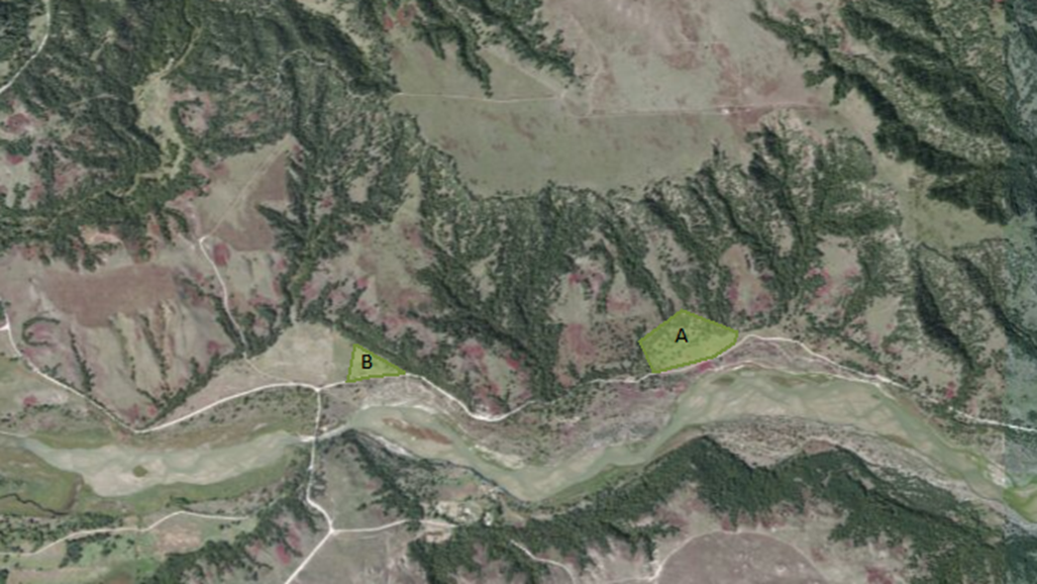
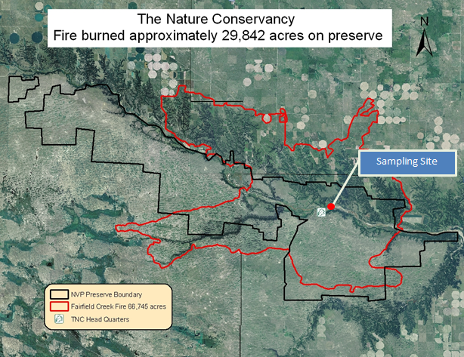
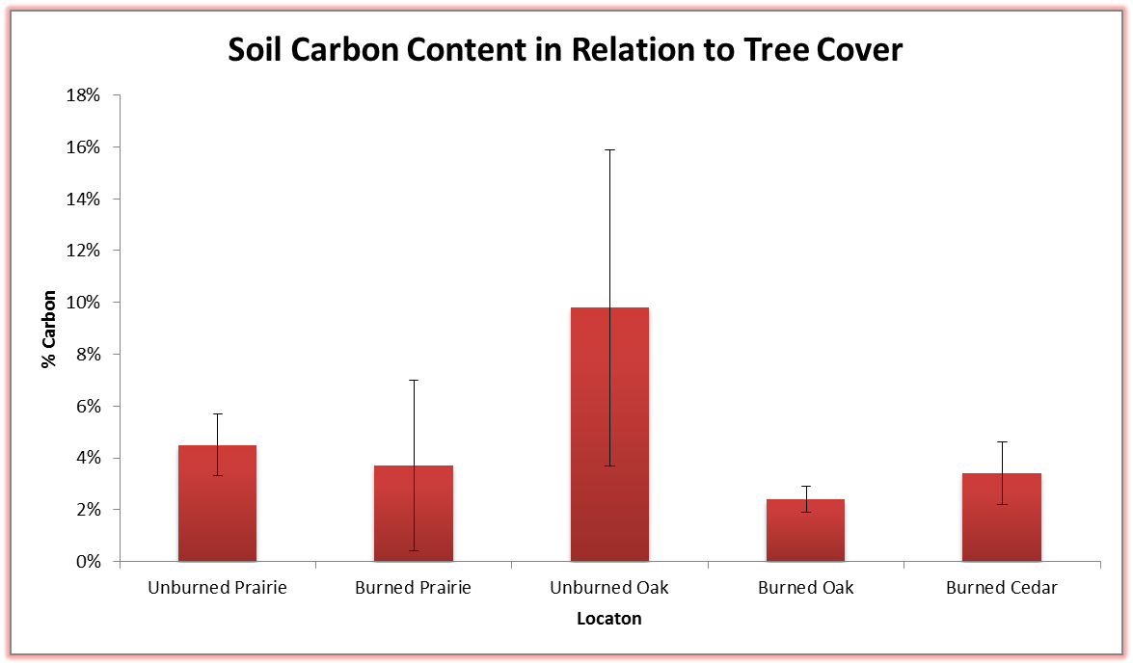
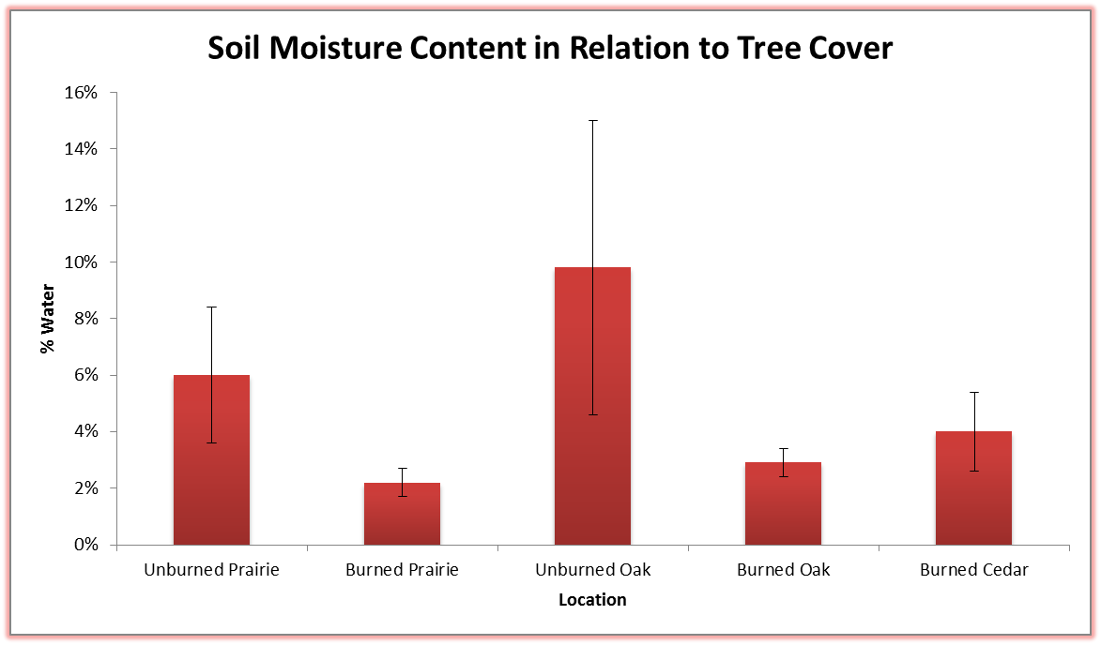
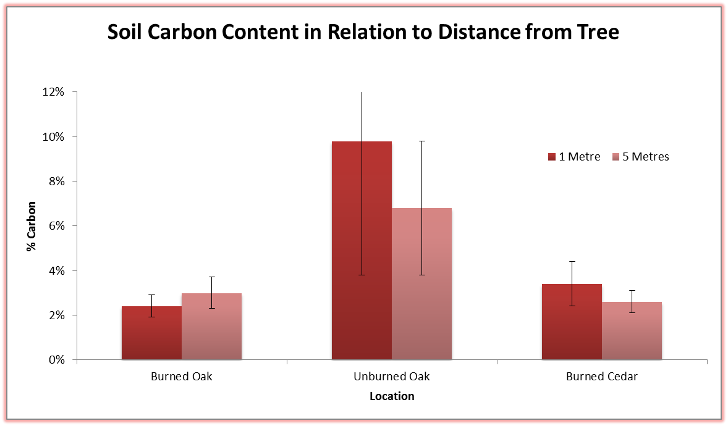
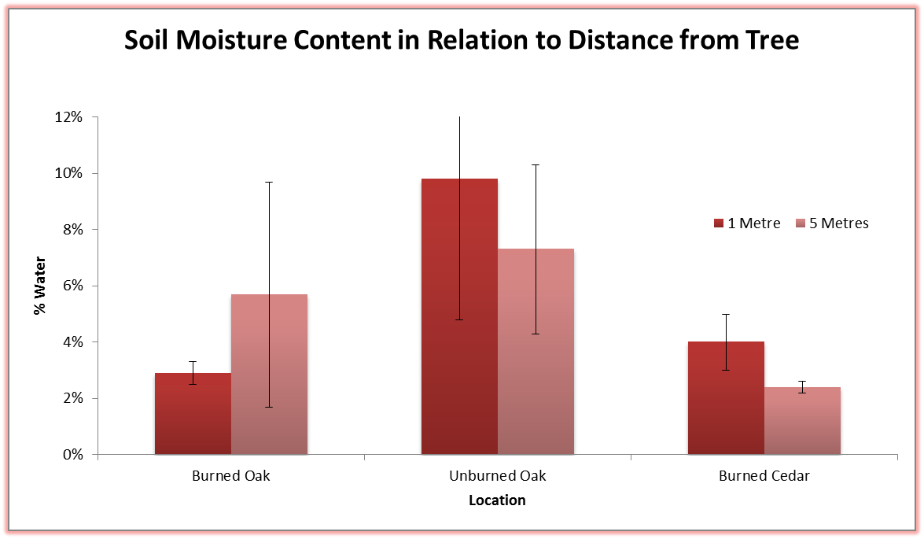
Earth, trees, and fire: Ecological interactions at Niobrara Valley Preserve
J. Reinders, K. Cleveringa, B. Schmidt, E. Stricklin, S. Kaltenbach, T. Tracy, and L. Furlong
Northwestern College, Orange City IA
Introduction
Fire is a major disturbance agent in savanna and prairie ecosystems; affecting species succession, reproduction, nutrient cycling, and biodiversity. In part, fire impacts ecosystems through its effects on soil structure, reducing of organic content and consequently reducing soil water retention. Higher temperatures and longer burn times increase the percentage of organic compounds in the soil that are lost due to oxidation, volatilization, and leaching, and has a greater effect on water content though evaporation and alteration of water holding capacity of the soil (Peng-Bo et al. 2013).These changes can influence post-fire recovery of plant and animal species.
Our experiment addressed the potential for tree cover and tree species to alter the effects of fire on soil characteristics and soil-associated macroinvertebrates. We focused specifically on carbon and moisture levels of burned and unburned soil near native red oaks (Quercus rubra), invasive eastern red cedar, (Juniperus Virginiana) and in open prairie environments. We also explored variations in macroinvertebrate richness and abundance at the same locations. In addition, we asked whether fire impacts on soil and macroinvertebrates would differ near invasive eastern red cedars.
We hypothesized that fire would have a more significant effect on soils underneath tree cover compared to soil in a prairie-like environment because the trees provide fuel for the fire, increasing the burn time and intensity of the fire in forested areas. We also hypothesized that macroinvertebrate communities would differ with vegetative cover and burn history. Due to low fire tolerance of cedars (Briggs et al. 2002) compared to fire adapted oaks, we predicted that macroinvertebrate richness and abundance would be lowest near the burned cedars , intermediate near burned oaks, and highest in unburned areas.
Study and Methods
In September 2013, we collected the soil samples and soil-associated macroinvertebrates from The Nature Conservancy Niobrara Valley Preserve (NVP) in northern Nebraska (Figure 1). The NVP surrounding areas experienced a severe fire in July 2012 (Hetzler 2013). The effects of the fire were visible at our study site near the Niobrara River. We compared samples from burned and unburned savanna communities. At our burned site, we used a bulb auger to collect soil samples from beneath (1 m from trunk) and near (5m from trunk) 6 burned red oaks, and 9 burned red redars. In addition, we collected 10 samples from a naturally burned grass dominated area. At the unburned site, we collected soil samples beneath and near 5 unburned red oaks . The auger produced cylindrical soil samples 5 inches deep and 2.5 inches in diameter. We removed approximately 1.5 inches of soil from the top and bottom of the sample, making a 2 inch disk. Each disk was stored in a ziplock bag until processed.
We processed a 6gr subsample from each soil plug. Each subsample was pre-weighed, dried (85ºC for 48 hours) and weighed again to determine soil moisture content. The dried samples were then placed in a muffle furnace (500ºC for 4 hours) and weighed again to assess carbon content. We used T-Tests to compare moisture and carbon content between different areas and at different distances from selected trees.
Pitfall traps (12 oz. solo cups containing 300ml of 50% ETOH + 1% dish soap) were placed tightly in the holes left by the soil auger. We recovered our samples from the traps after 24 hours. The samples were stored in ziplock bags. The collected macroinvertebrates specimens were identified to morphospecies in the lab. We used ANOVAs and t-tests to determine whether tree species, distance from trees, and fire history influenced macroinvertebrate richness and abundance.
Abstract: Fire plays a prominent role in shaping ecosystems. In 2012, a large wildfire burned at the Nature Conservancy’s Niobrara Valley Preserve in north-central Nebraska. Areas burned include mixed grass prairie, ponderosa pine and oak woodlands, and stands of eastern red cedar, a fire-intolerant species that has become problematic in the Great Plains in the absence of fire. We collected soil samples in burned and nearby unburned areas of the preserve and analyzed samples for carbon and moisture content. We also used pitfall traps to survey ground-associated macroinvertebrates at each soil collection site. In this poster, we discuss our findings regarding interactions between fire history, soil properties, tree type (oak vs. cedar), and invertebrate diversity.
Results
We found that soil from burned prairie samples had significantly less moisture content than soil from unburned prairie samples (P=0.02). Similarly, soil taken at 1 meter from unburned red oak had significantly higher carbon and moisture content than soil beneath burned oaks (P=0.03, P=0.02). We also found that in the area affected by fire, soil beneath the red cedar had significantly higher carbon content (P=0.04) and almost significantly higher moisture levels (P=0.052) than soil beneath red oak. When comparing soil properties in relation to distance from tree, we found that moisture content decreased as distance from burned red cedars increased (P<0.01), while no significant differences were found for burned red oaks (Figure 3).
We observed that overall macroinvertebrate richness and abundance did not vary significantly with burn regime and vegetation type (ANOVA P>0.05); however, the beetle richness and abundance did vary significantly (ANOVA P< 0.05). Beetle richness was significantly higher in the unburned samples compared to the burned prairie and burned cedar samples (TTest P<0.05, Figure 4a) . Beetle abundance was significantly higher in the unburned samples than in the burned grass samples (TTest P<0.05, Figure 4b).
Discussion
Comparing soil properties and macroinvertebrate populations from areas differing in burn regimes and plant cover gave us insights regarding how disturbance regime impacts community structure and function. Our results showed that, even after 14 months of recovery, the soil samples from all burned sites had significantly less carbon and moisture content than their unburned counterparts, We also found that soils under red cedar trees had higher levels of moisture and carbon than soil under red oak in burned areas. In addition, we noticed that moisture and organic content was higher at the base of burned cedars than in surrounding soil, while the opposite trend occurred with oak trees. This could indicate that red cedars affect soil differently than the native red oaks, but we recommend that more research be conducted before any conclusions are made concerning eastern red cedar.
The variation in soil properties between the burned and unburned sites could be due to the high intensity of the fire in Niobrara, which resulted from the invasion of red cedar and a buildup of combustible materials over a long period of fire suppression. Under natural fire patterns for that area, regular low intensity wildfires would have prevented a larger fire by removing ground litter before it accumulated (Arnos & Allison-Bunnell 2002). Had the fire been of lower intensity, our data may have shown a more noticeable trend between tree species and soil properties.
One of the reasons why all three sites in the burned research area showed similar levels of carbon and water can possibly be attributed to where moisture and carbon accumulate in soils. Over 80% of organic matter and water in soil is found in the top layer, called humus (Evangelou 1998). Although this material is found in much higher densities under tree cover than in open environments, the majority of it is consumed during a fire, regardless of density (Nave et al. 2011). Once the humus layer is burned, soil undergoes a process of transition from larger to smaller particles as sand particulate breaks down into silt and clay under the high heat (Stoof et al. 2010). This results in fairly uniform soil composition throughout the burn area.
Beetles are frequently used as bioindicators of environmental change. Despite limitations of sample size, we were able to detect differences in beetle populations that may reflect community-level responses to change in vegetative cover and soil properties related to fire disturbance. Continued work with other soil-associated macroinvertebrates may also reflect these changes, but they were not the focus of our study.
Unburned Prairie, and Unburned Oak
Burned Oak, Burned Cedar, and Burned Prairie
.5 miles
2 miles
Figure 1. Study areas at TNC Niobrara Valley Preserve. The map on the left shows the burned (A) and unburned (B) research areas. The map on the right shows the Niobrara Nature Conservatory area in relation to the area affected by fire.
P=0.03
P=0.02
P=0.02
P=0.052
P=0.04
Figures 2a and 2b. Type of vegetative cover and the percentage of the soil (by weight) made up of either organic compounds (a) or water (b). Error bars indicate standard deviations. Horizontal bars indicate relevant comparisons that were at least marginally significantly different (P<0.10).
1 Meter
5 Meters
1 Meter
5 Meters
P<0.01
Figures 3a and 3b. The differences in carbon and moisture content between samples taken at 1 meter from the tree base and samples taken 5 meters from the tree base. Soil beneath burned red cedars was significantly higher in moisture content than soil at 5m. No other significant comparisons were found. Error bars indicate standard deviations.
B
C
AB
B
A
AB
B
AB
AB
B
A
A
References
Arno S. F., & Allison-Bunnell S. 2002. Flames in our forest: Disaster or renewal?.
Washington D.C: Island Press
Briggs, J., A. Knapp and B. Brock. 2002. Expansion of Woody Plants in Tallgrass Prairie:
A Fifteen-year Study of Fire and Fire-grazing Interactions. American Midlands Naturalist 147:287-294.
Evangelou, V. P. 1998. Environmental soil and water chemistry: Principles and applications. New York, NY:
John Wiley & Sons Inc.
Helzer, C. 2012. Second Update on Wildfire Impacts at the Niobrara Valley Preserve. http://prairieecologist.com/2012/08/01
Nave, L. E., Vance, E. D., Swanston, C. W., & Curtis, P. S. 2011. Fire effects on temperate forest soil carbon and nitrogen
storage. Ecological Applications 21(4): 1189-1201.
Stoof, C. R., Wesseling J. G., & Ritesma, C. J. 2010. Effects of soil and ash on soil water retention. Geoderma 159(4): 276-285.
Xu, P., Ming, Q., & Xue, L. 2013. Effects of forest fire on forest soils. Shengtaixue Zazhi 32(6): 1596-1606
Figures 4a and 4b. Differences in beetle richness and abundance varied significantly with location (ANOVA p<0.05). Significantly different means are indicated with different letters (T-test p<0.5). Error bars indicate standard deviations.
Location Key: BG= Burned Grasse. BC= Burned Cedar, BC5 = 5m from Burned Cedar, BO = Burned Oak, UO = Unburned Oak, UO5= 5 meters from Unburned Oak

